Slide 1


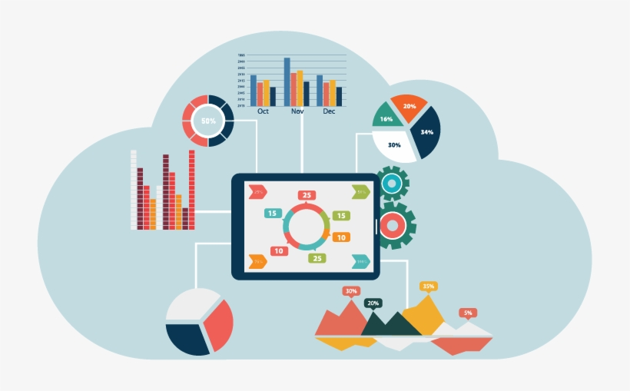
Bank Loan of Customers | Finance Data Analyst P-193
Mentor :
Group no : 5
Group Members
Robin Roy
Vrushali Shinde
Devesh Gaonkar
Meera Pal
Abhinandan Kumar
Vaibhavi Pawar
Sakshi Bais

Slide 2
Project Objective
This is Bank loan of Customers project where we were provided with 2 datasets with .csv extension files having 39k rows each and the objective was to analyze the growth that bank got within given years in loans.
We used MS-Excel, MySQL for analyzing, cleaning and removing duplicates from dataset and prepared dashboard using Tableau and PowerBI tools where we did calculations, merging and prepared interactive dashboards.

Slide 3
Contents
KPI-1 : Year wise loan amount Stats
KPI-2 : Grade and sub grade wise revol_bal
KPI-3 : Total Payment for Verified Status Vs Total Payment for Non Verified Status
KPI-4 : State wise and last_credit_pull_d wise loan status
KPI-5 : Home ownership Vs last payment date stats

Slide 4
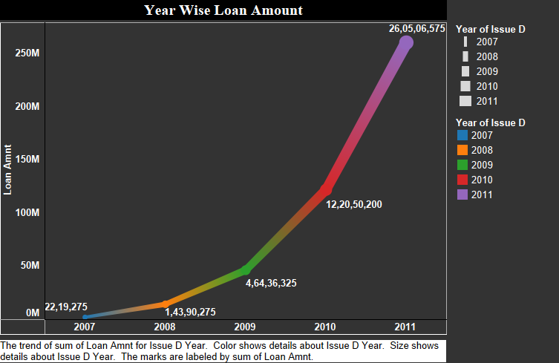
KPI-1
Year wise loan amount Stats :
By observing the chart we can see how Loan Amount is increasing by year.
Starts from 2007 the loan amount is 22,19,275 and in the 2011 the loan amount is 26,05,06,575. We can subtract the new value to the old value to see the difference
26,05,06,575 - 22,19,275 = 258287300
258287300 increased in the duration of 4 years
And Grand Total of all years is 44,56,02,650.00
Year wise Loan amount Stats
SUM OF LOAN_AMNT
Issue Date | Total
2007 | 22,19,275.00
2008 | 1,43,90,275.00
2009 | 4,64,36,325.00
2010 | 12,20,50,200.00
2011 | 26,05,06,575.00
Grand Total | 44,56,02,650.00

Slide 5
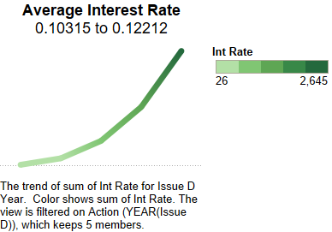
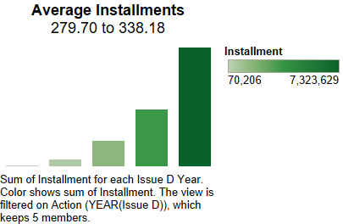
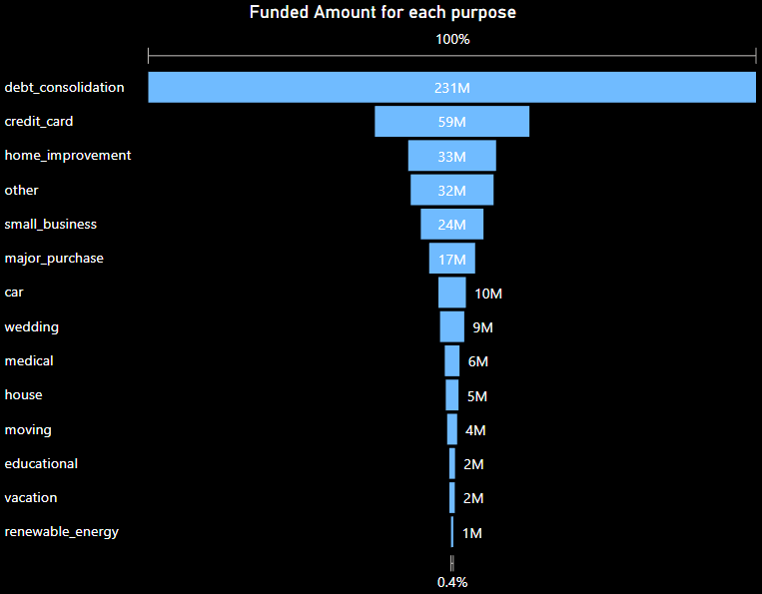
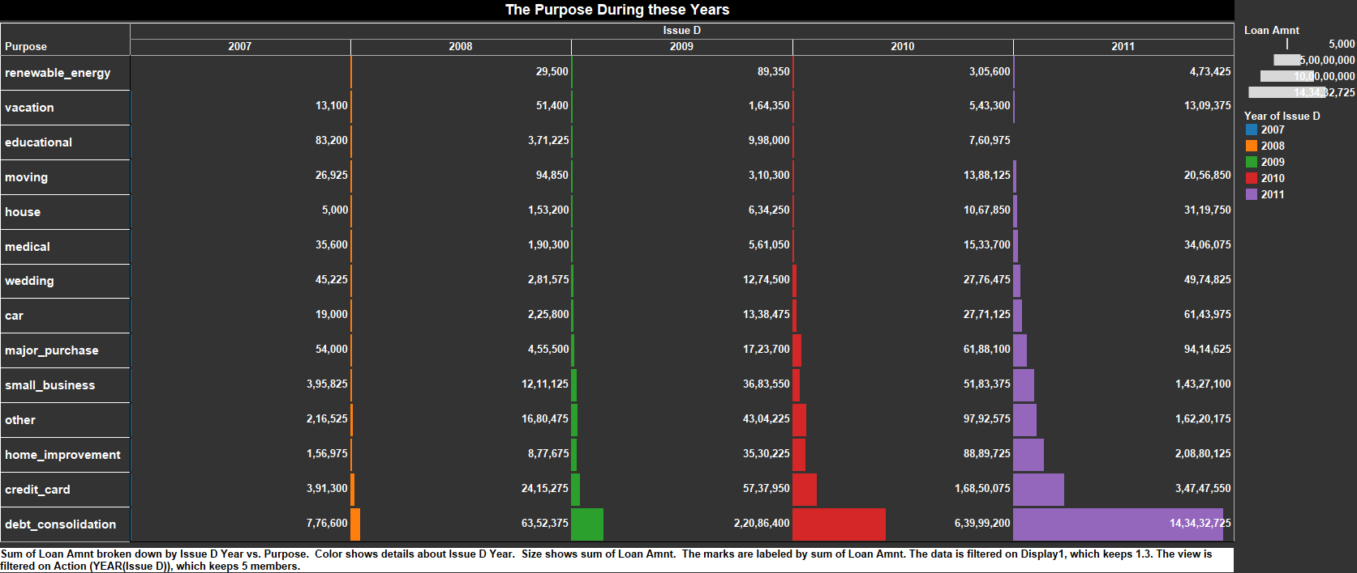
KPI-1 Sub-Charts
Avg Interest Rate & Avg Installments & Purpose Of Taking Loan :

Slide 6
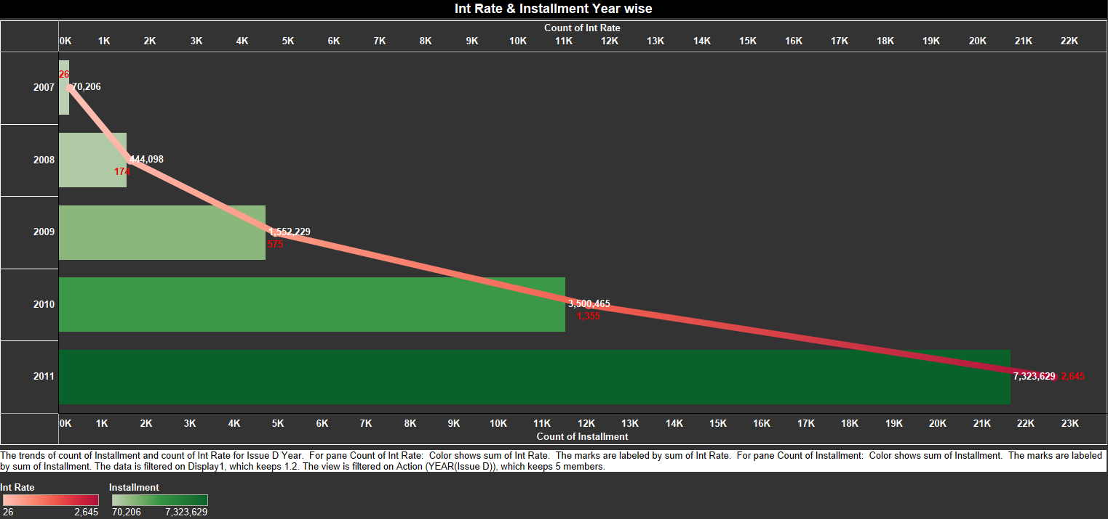
KPI-1 Sub-Charts
In this chart interest rate and dept installments both are increasing year by year
As interest rates move up, the cost of borrowing becomes more expensive

Slide 7
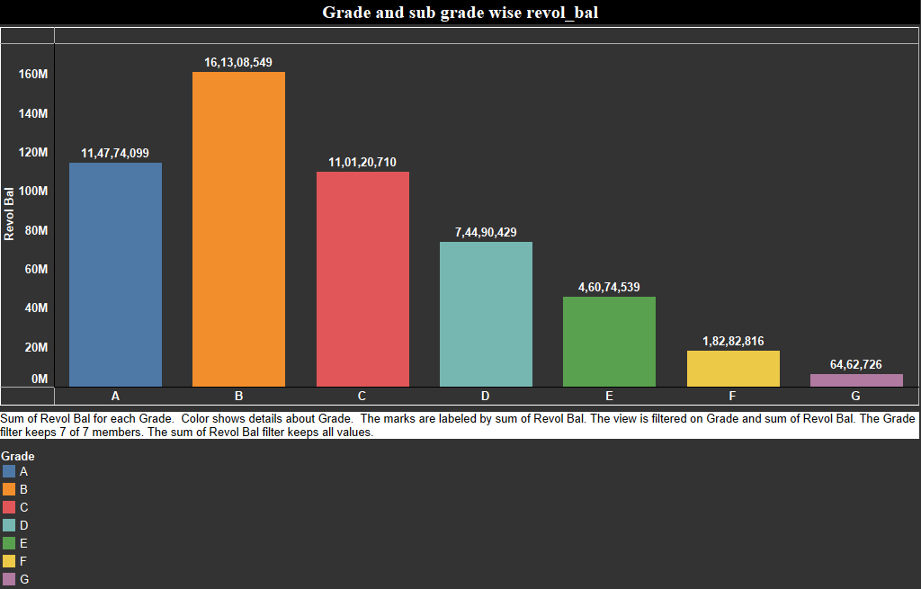
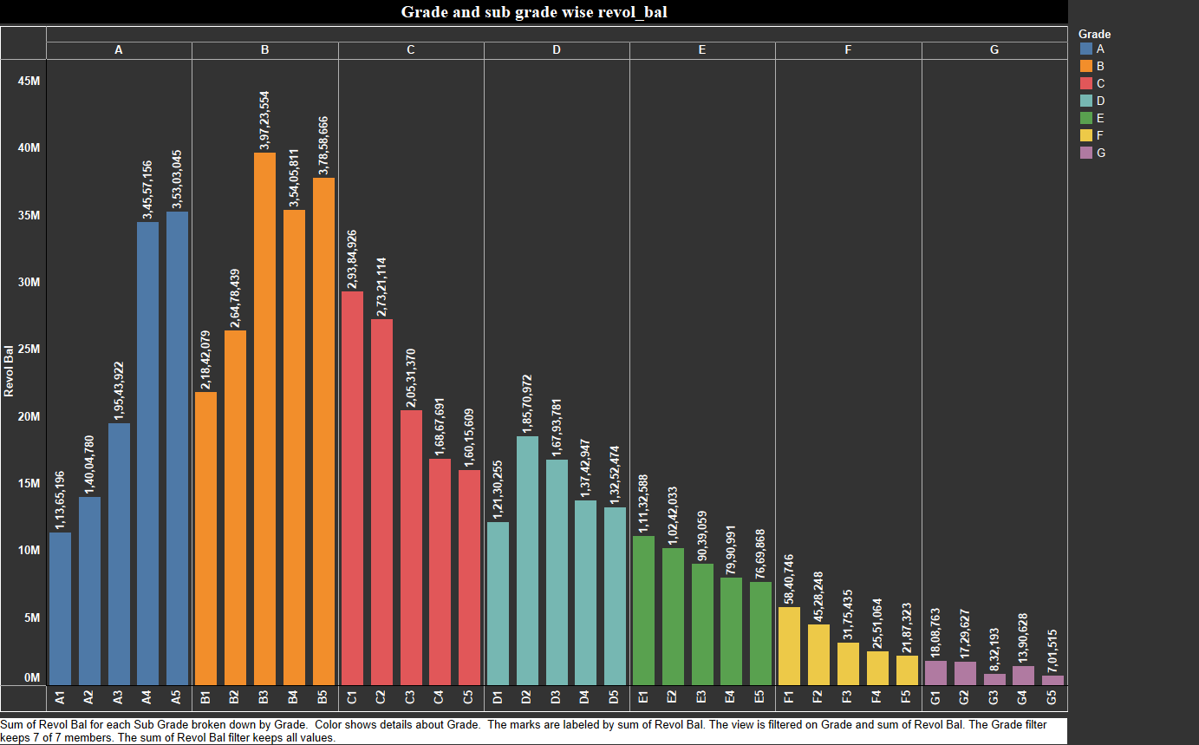
KPI-2
Grade and sub grade wise revol_bal :
In this Grade and subgrade wise revol balance we can notice Grade-B have more revol balance then any other grade & Grade-G have very low revol balance.
As we can see that Grade B customers has higher annual income for 10+ yrs of employment period, so higher the annual income lower the Debt to income ratio and hence, more number of customers took loan in Grade B .
Similary, it goes for other grades also B>A>C>D>E>F>G order for revol bal as per annual income

Slide 8
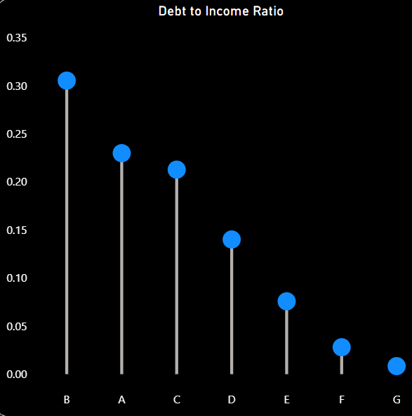
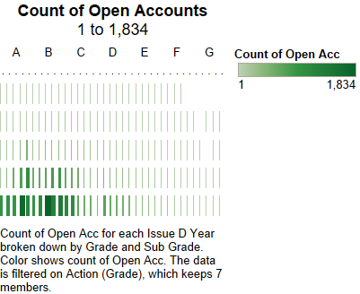
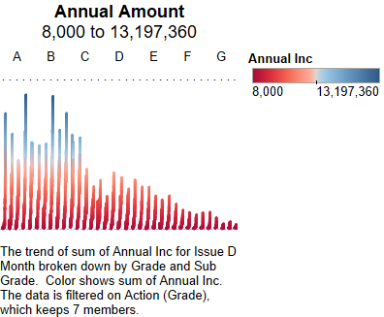
KPI-2 Sub-Charts
Count of Open Accounts in All Grades are 1834 total
Annual Amount in All Grades are 8000 to 13,197,360

Slide 9
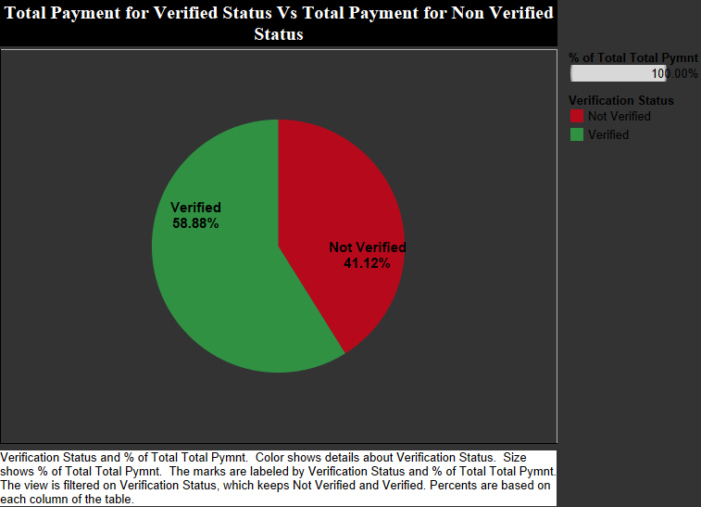
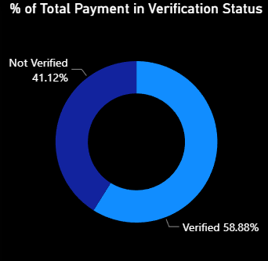
KPI-3
Total Payment for Verified Status Vs Non Verified Status :
This is the first stage of the verification process. The bank needs a loan application to initiate the document collection and verification process
Looking at pie chart we can observe that verified status have 58.88% of total payment and 41.12% of total payment which are Not Verified for the Loan Amount

Slide 10
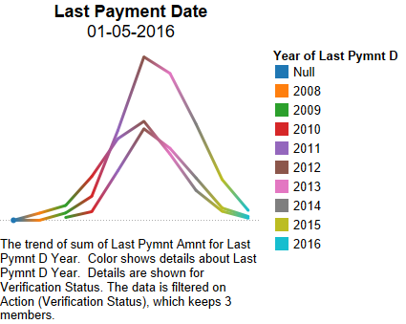
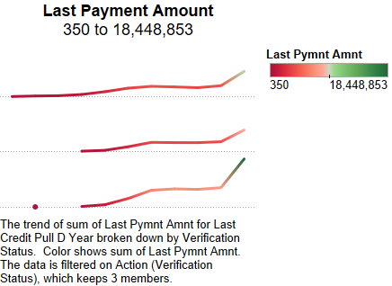
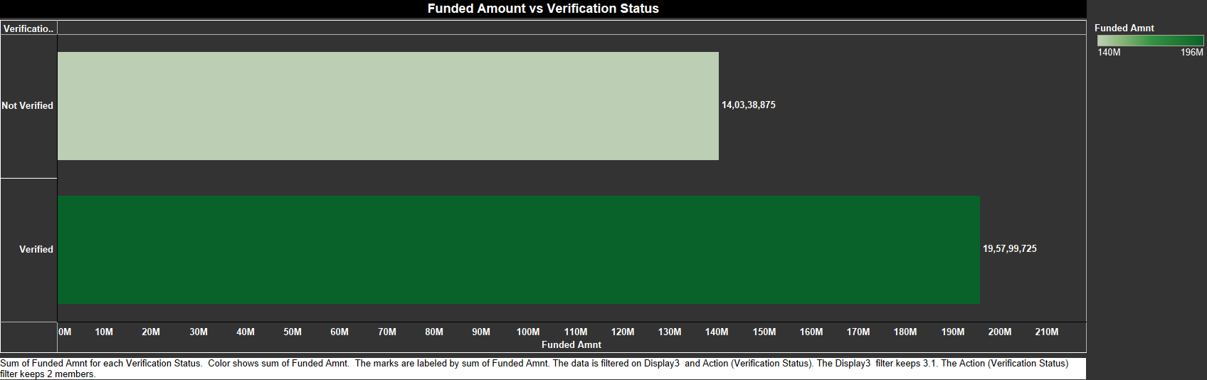
KPI-3 Sub-Charts
Last Payment Date:
Last Payment Amount :
This Ratio shows us how many people are non verified with there Total funded amount 14,03,38,873 similarly Verified with 19,57,99,725 total

Slide 11
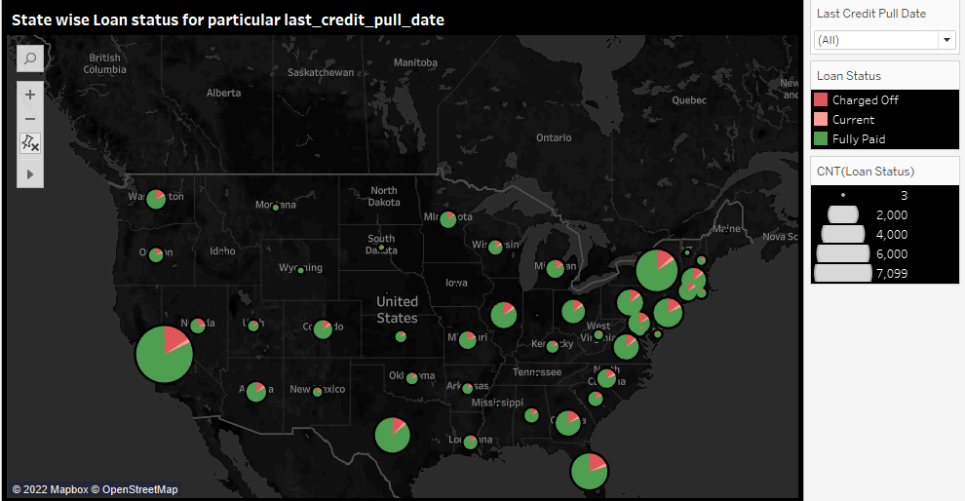
KPI-4
State wise and last_credit_pull_d wise loan status insights:
The right graph shows the count of Loan Status in each state of USA on particular last credit pull date.
As we can see CA has given maximum customers who took Loan i.e >5000 is the count of loan status
This clearly shows that 97% of bank customers have fully paid status for each state.

Slide 12
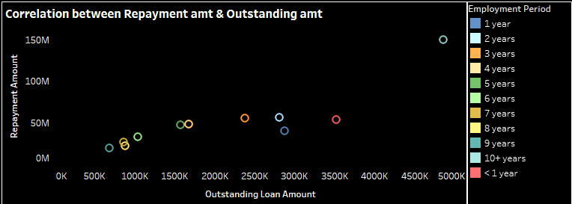
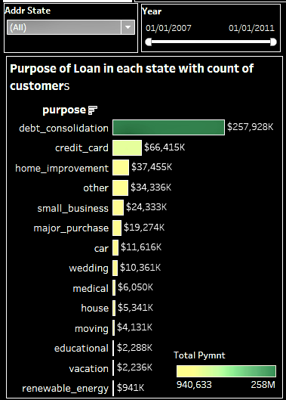
KPI-4 Sub-Charts
So, here the above graph shows that Loan amount of customers who paid their Loan(Repayment Amount) versus Loan amount of customers who are left to pay their loan(Outstanding Amount). This clearly shows that customers with 10+ yrs of employment period has paid their loan, so has maximum fully paid status.
The right graph shows that for what purpose customers took loan in each state. As per observation, If we see for particular state, customers took highest loan in debt_consolidation and lowest for renewable_ energy. Therefore, customers with debt_consolidation purpose has to pay more outstanding amount, so that many of the states will get fully paid status.

Slide 13
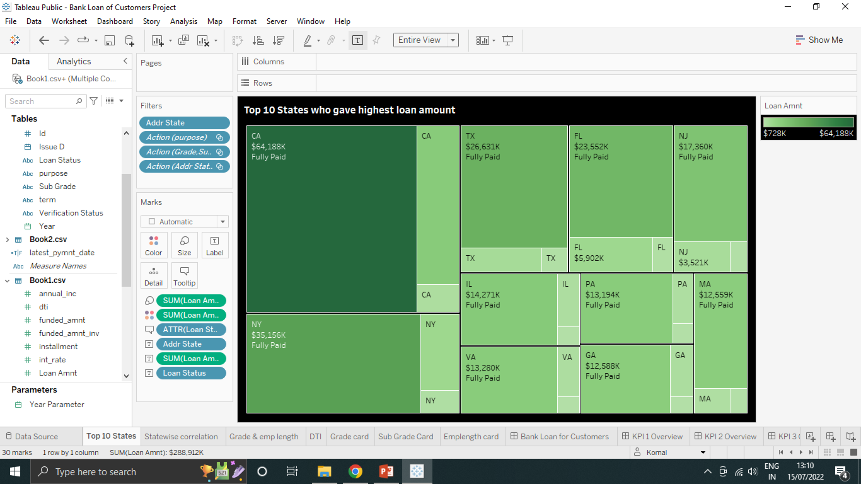
KPI-4 Sub-Charts
The graph above shows the Top 10 states to whom bank gave the highest amount of Loan.
Here , it is clearly seen that in top 10 states, CA has given highest amount of loan to customers and lowest is MA. But, maximum of customers in each state has fully paid status followed by Charged off and current.

Slide 14
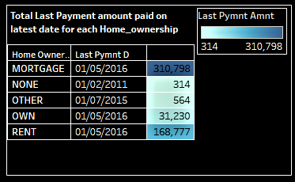
KPI-5
Home_ownership versus last payment date stats insights:
The right graph shows the Home ownership and the amount paid for each on last payment date.
Here, we can see that maximum latest amount paid by customers with MORTGAGE home ownership is Rs.310,798.
It concludes that many of the customers are about to repay their loan amount for their particular home ownership.

Slide 15
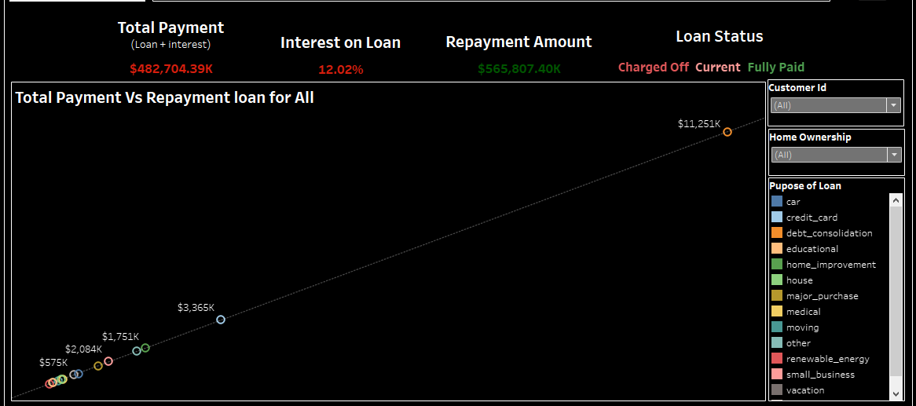
KPI-5 Sub-Charts
As we saw that last payment loan amount is paid highest by mortgage for latest date. Here, the right graph shows the total loan took by customers for each home ownership with int and amount paid to the bank and their loan status.
We can conclude that in each home ownership, maximum loan is taken for debt_consolidation and also customers who took loan for this purpose has repaid in mass amount.
Except NONE and OTHERS, all other Home_ownership has maximum took loan for debt_consolidation. So, recently paid max amount is of MORTGAGE followed by RENT and OWN.

Slide 16
Thank You
For Your Attention

